Slide 1


How Missing Women in 90-00s
affects Rural Marriage Market
in China Nowadays ?
Unmarried Rate
Unmarried Rate
Y vs X
Y vs X
Keyi Luo
Hourui Guo
Yuanjin Zeng
Yichi Yang
Mentored by Prof. Xiaogang Wu
Sex Ratio
Sex Ratio
Notes:
Undergraduate research Research problem is/
What brings us to focus this problem
The missing women puzzle has been first brought up by the Nobel Economics Prize laureate Amartya Sen in 1990s. It refers to the shortfall of the number of women in Asia. According to the normal ratio of women to men in other countries, we could estimate that at least more than 100 million women are missing in Asia, which means that their potential existence has been eliminated, mostly because of gender-based abortion.
There are many researches investigating the causes of missing women problem but little about its consequences.
Thus, our research team investigates the relationship between unbalanced sex ratios in 90s with rural marriage rate 20 years later. In order to better outline their relationship

Slide 2
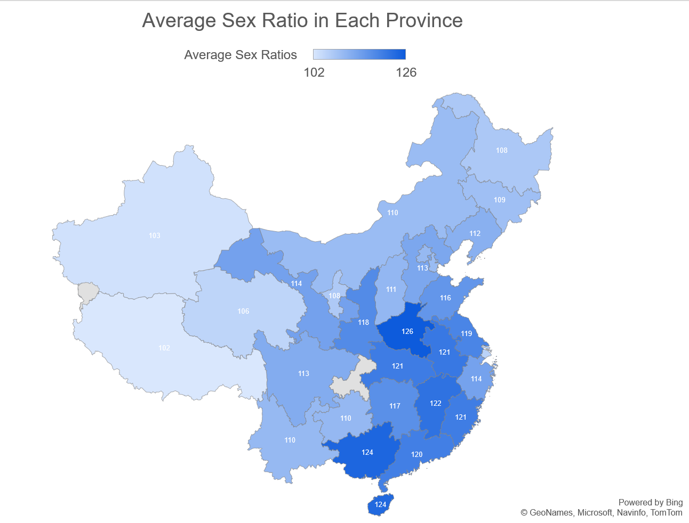

Research Approach
Research Problem
Narrow down Research focus
X-Y Regression
Missing Women Problem: the shortfall of the number of women in Asia & focus on the problem in China.
our research team focuses on the consequences of missing women puzzle in marriage market in the rural areas.
Finding 5 out 31 Provinces in China with most unbalanced sex ratios & focus on rural area within these provinces
X | Sex Ratio at 1990s | Sex Ratio at 2000s
Y1 | Male Unmarried Rate at 2010s | Male Unmarried Rate at 2020s
Y2 | Female Unmarried Rate at 2010s | Female Unmarried Rate at 2020s
Sex ratio: Male at birth/ Female at birth
Unmarried Rate= single population of (male OR female)/ Total population
Notes:
How Data Analytics guides our Research Approach in a social science study
Research problem:
Missing women problem: more than 100 million women are missing in Asia
Narrow down research focus:
Because rural area has more unbalanced sex ratios

Slide 3
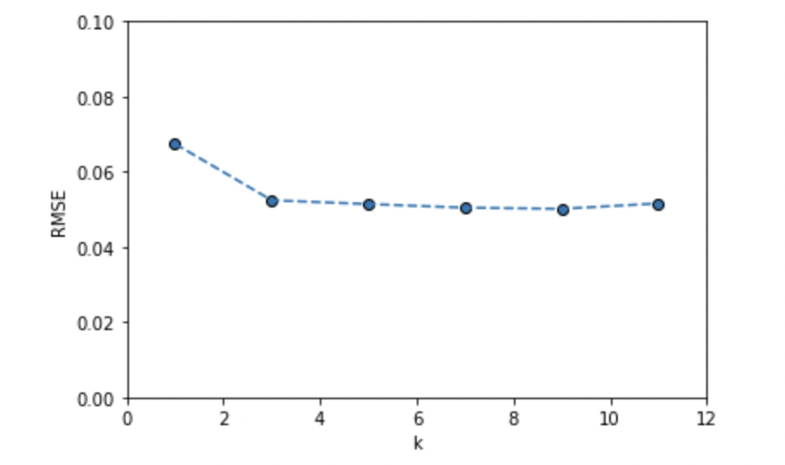
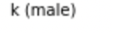
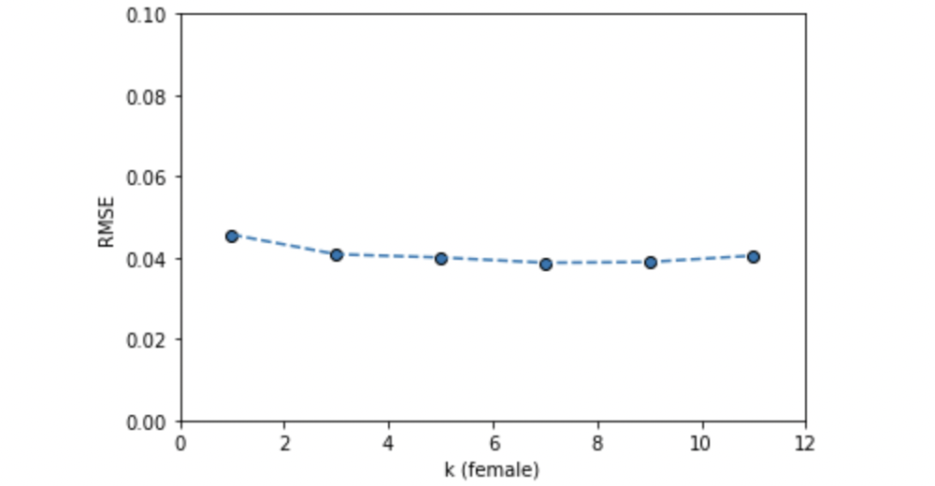
Regression Selection - KNN Model
KNN Model
k=9 gives lowest RMSE
-Male
On Avg K=9 fits best
Avg RMSE: 0.050
-Female
On avg K=7 fits best
Avg RMSE: 0.0479
-Limitation of this model: Works more widely on the non-parametric settings
k=7 gives lowest RMSE
Notes:
For our quantitative research part, In order to know which regression fits the data best
I gathered datasets from statistics bureau and do the data cleaning using python and SQL. Also, for missing datas, I made predictions or taking averages to make sure the datasets are ready to be used in models
KNN model
uses proximity to make classifications or predictions about the grouping of an individual data point.
For the male notation, I mean the relationship between x and Y1
Female x and Y2
Find best fit k-values and their corresponding RMSE.
RMSE: Root-mean-square deviation, usually between 0-1. The closer to 0, the smaller the difference between average difference between values predicted by a model and the actual values.
RMSE in KNN model is pretty good, but what makes me give up this model is that ….

Slide 4
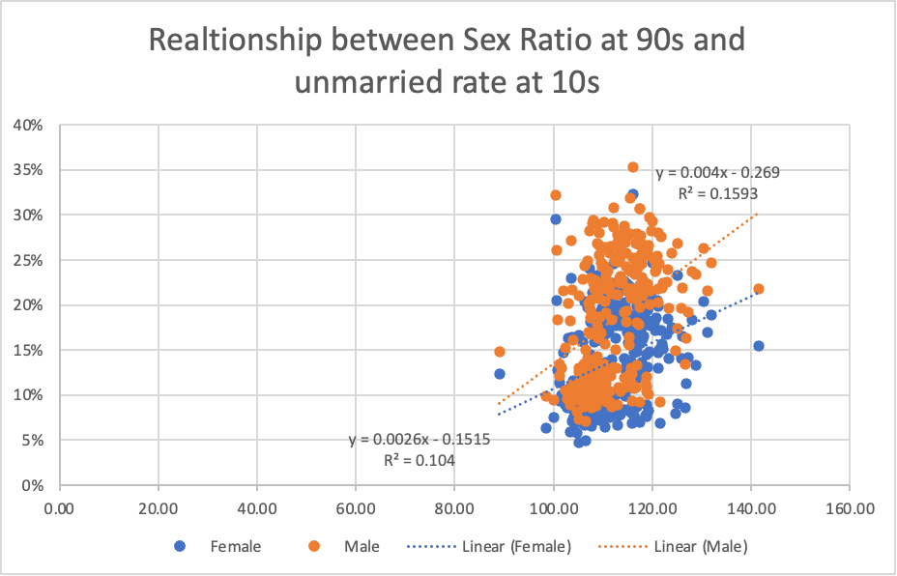
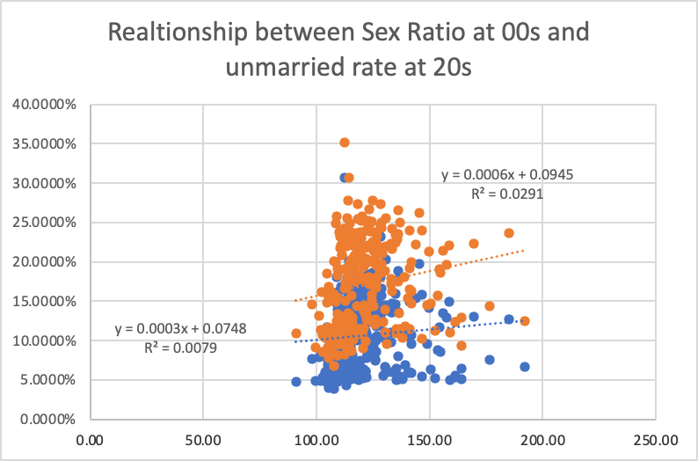
Regression Selection - Linear
Linear Regression Model
-Male
Avg R²: 8.5% Avg RMSE: 0.07
-Female
Avg R²: 5.6% Avg RMSE: 0.053
-Limitation of this model: Low R² (below 10%) indicates the data fits this linear regression model poorly.
Average t-value is 1.465, not statistically significant.
Notes:
Linear Model
Avg R^2 is relatively low
T-value is not statistically significant
All of these shows that this regression model fits my data poorly

Slide 5
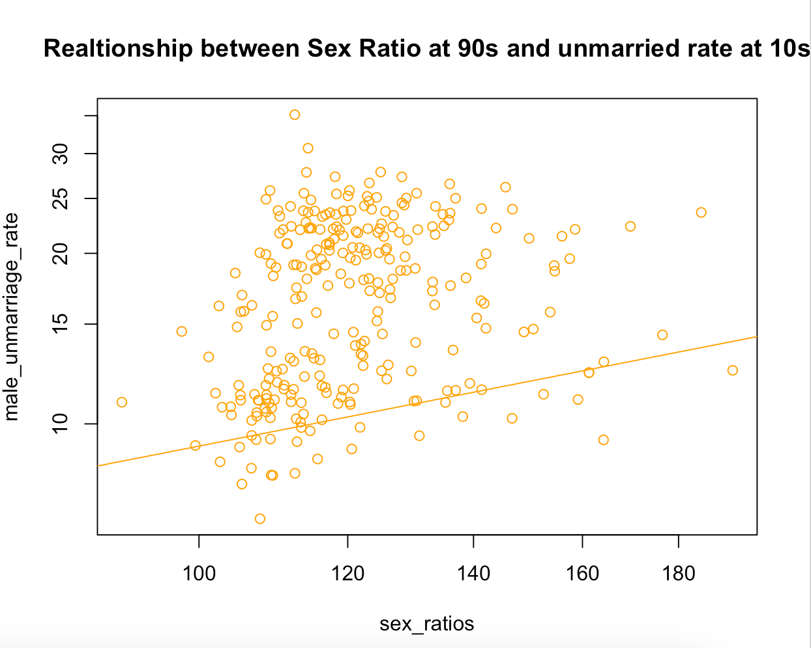
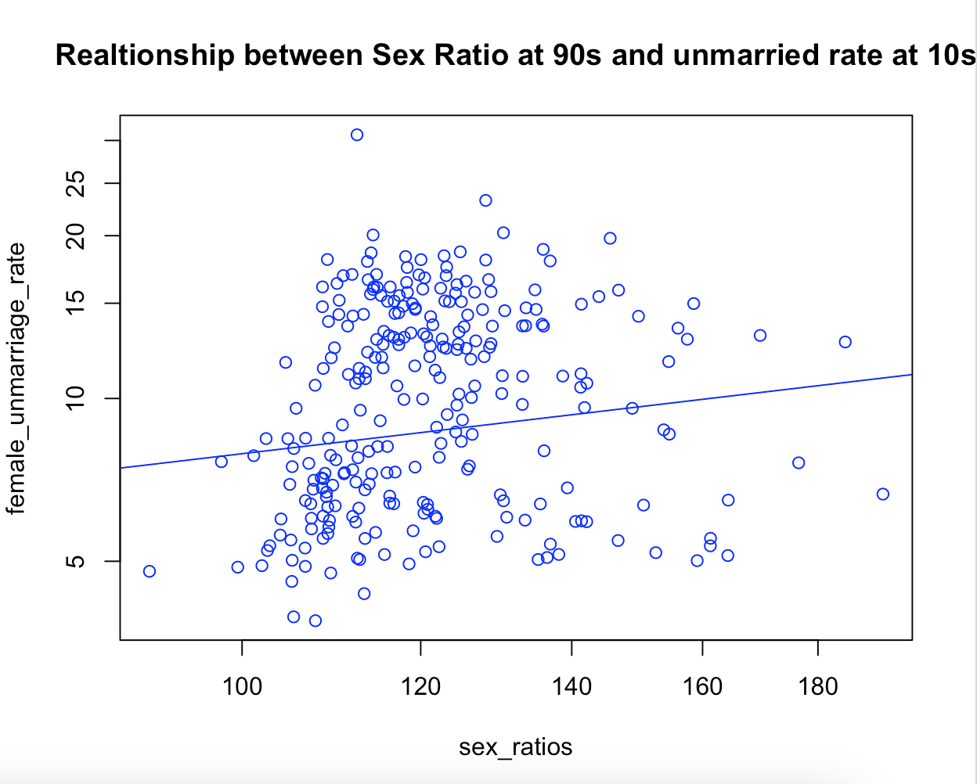
Regression Selection - Log-linear
Log-linear Regression Model
-Male
Avg R²: 17.44 % Avg RMSE: 0.37
-Female
Avg R²: 12.45% Avg RMSE: 0.39
-Advantages of this model: Avg R² is highest, 12%-18% is an acceptable percentage in social science studies
Average t-value is 2.21, statistically significant.
-Limitations: there are many other independent variables that may account for male and female unmarried rate difference. Bias in the regression should be further evaluated. E.g. female emigration rate from rural to urban area
Notes:
R^2 is improved to 12% and 17%, although it may seem low, but it is an Acceptable R^2 in social science because there are so many interrelated independent variables affecting unmarried rate in social science
Relatively good RMSE —-> RMSE values between 0.2 and 0.5 shows that the model can relatively predict the data accurately
Also, all of the abovementioned and statistically significant t-values makes me choose this log-linear model
However, should still give consideration to the limitations of other bias.

Slide 6
Conclusion
-Rural Males are hurt from unbalanced sex ratios and rural marriage market collapses.
approximately 2% higher male unmarried rate than female as sex ratio increases
-Social Impact of “Missing Women Problem” and Collapse of Rural Marriage Market
-antagonism between men and women
-reduction in birth rate
-aging population
-human trafficking
Notes:
Ironically, rural males eventually hurt from missing women problem although they seem to have advantage at birth.
Consider bias like female emigration rate could make this regression more accurately
Social impact:
Human trafficking
Reduction in birth rate
antagonism between man and woman

Slide 7
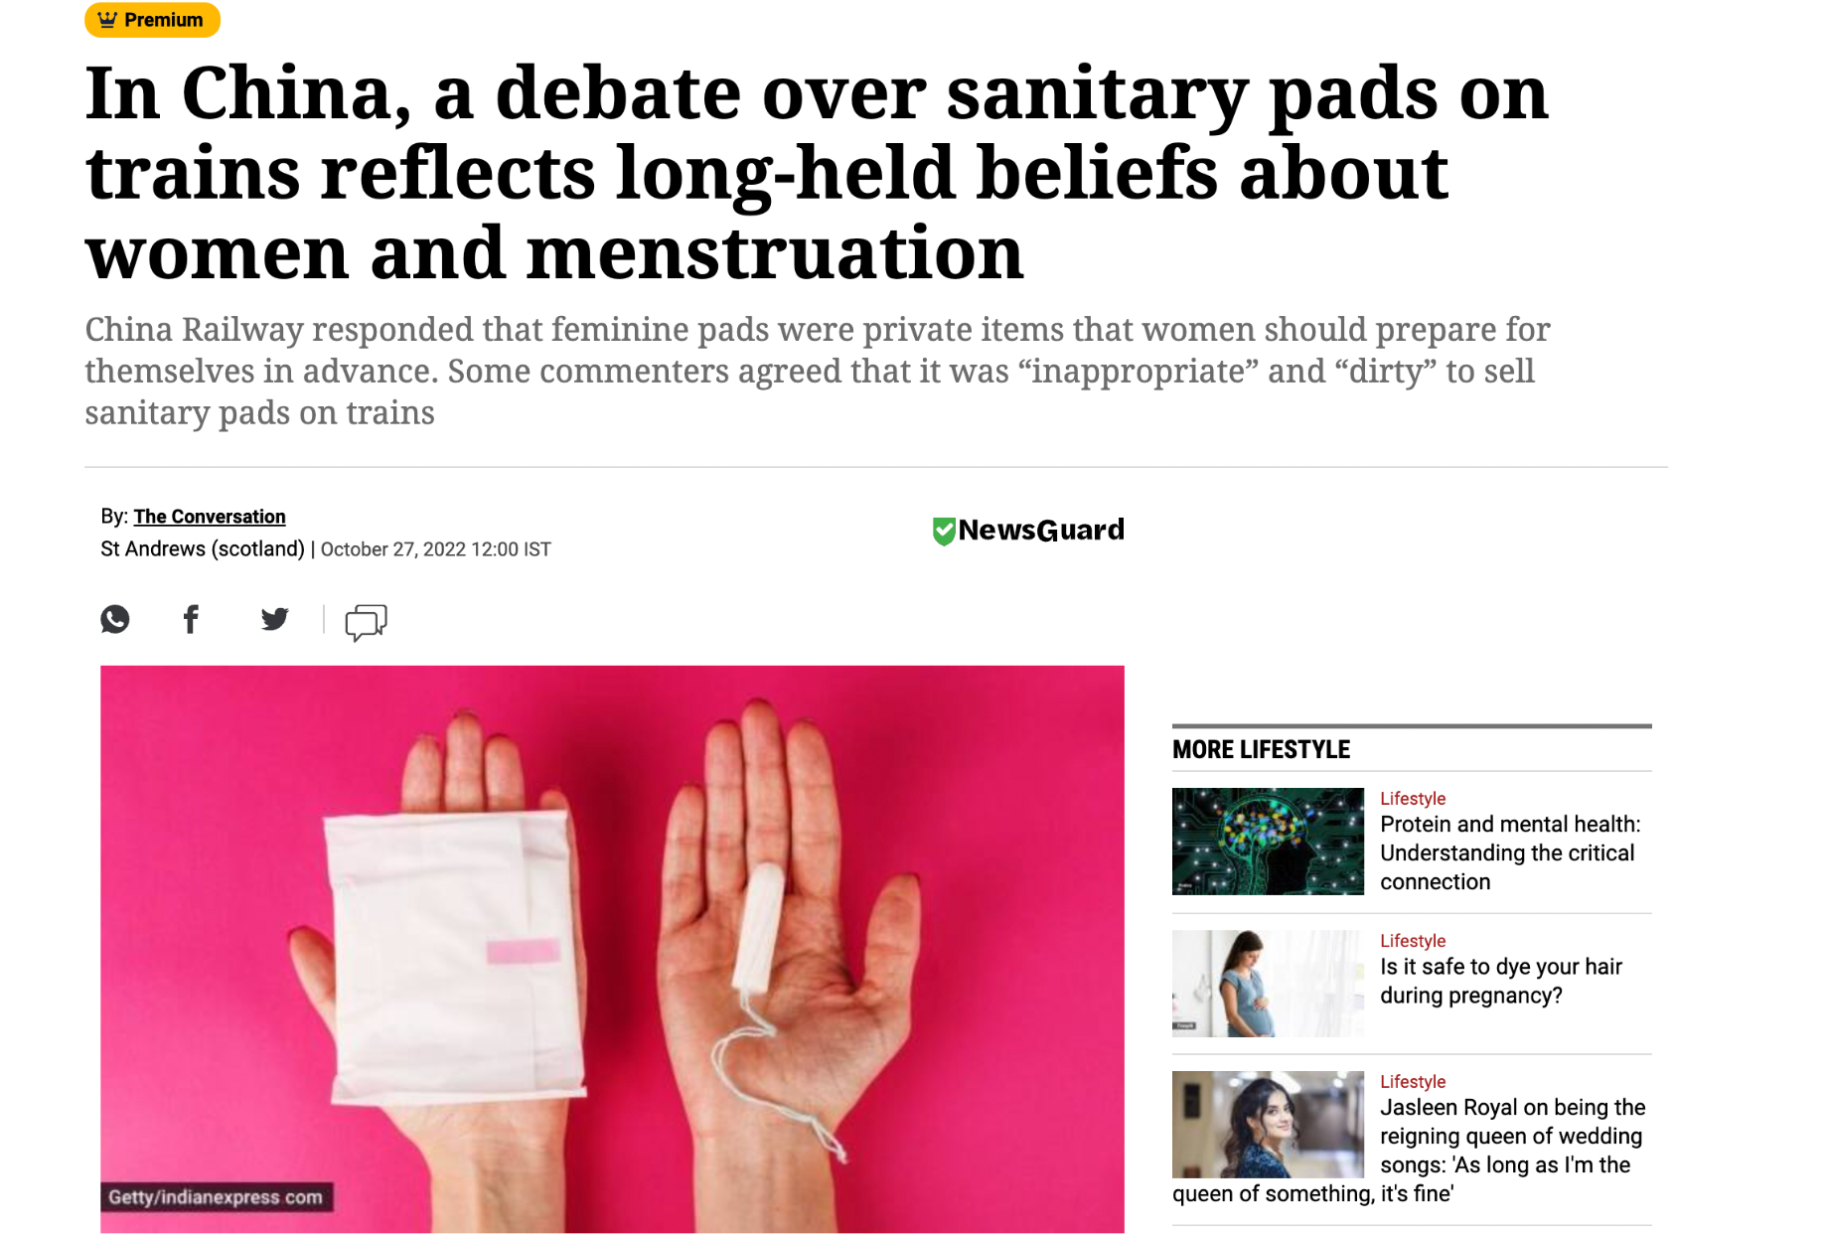
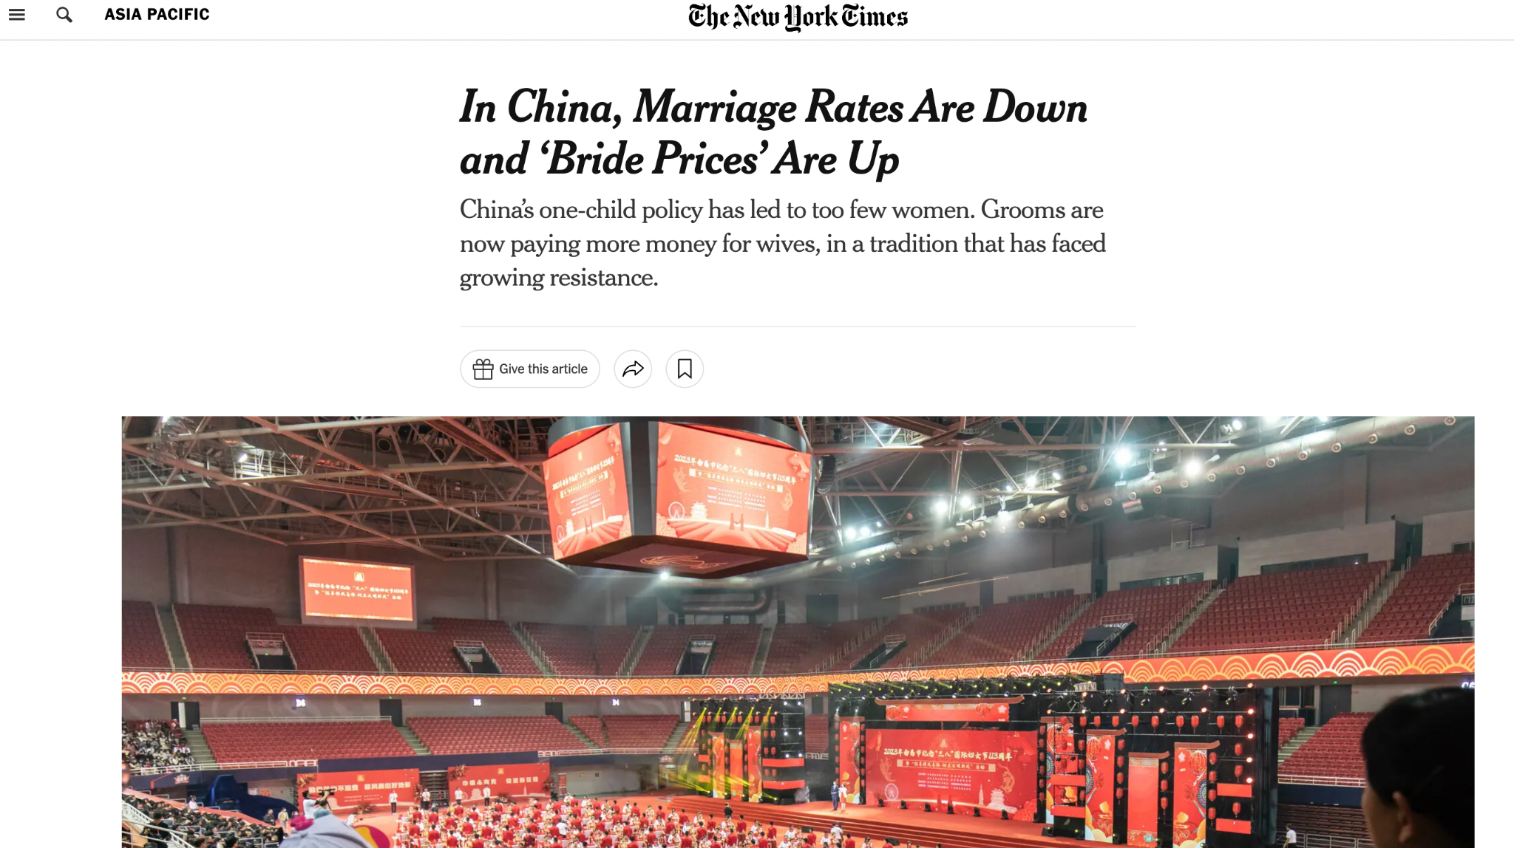
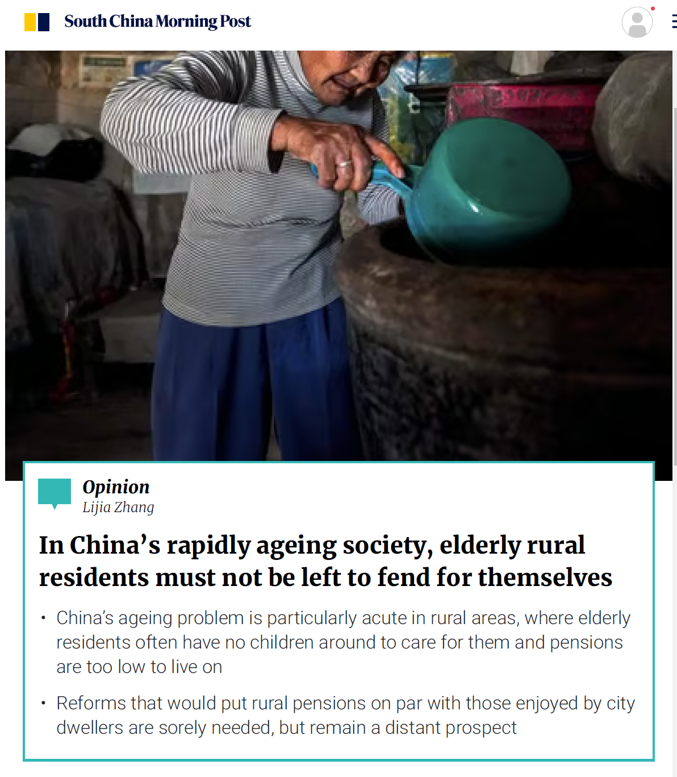
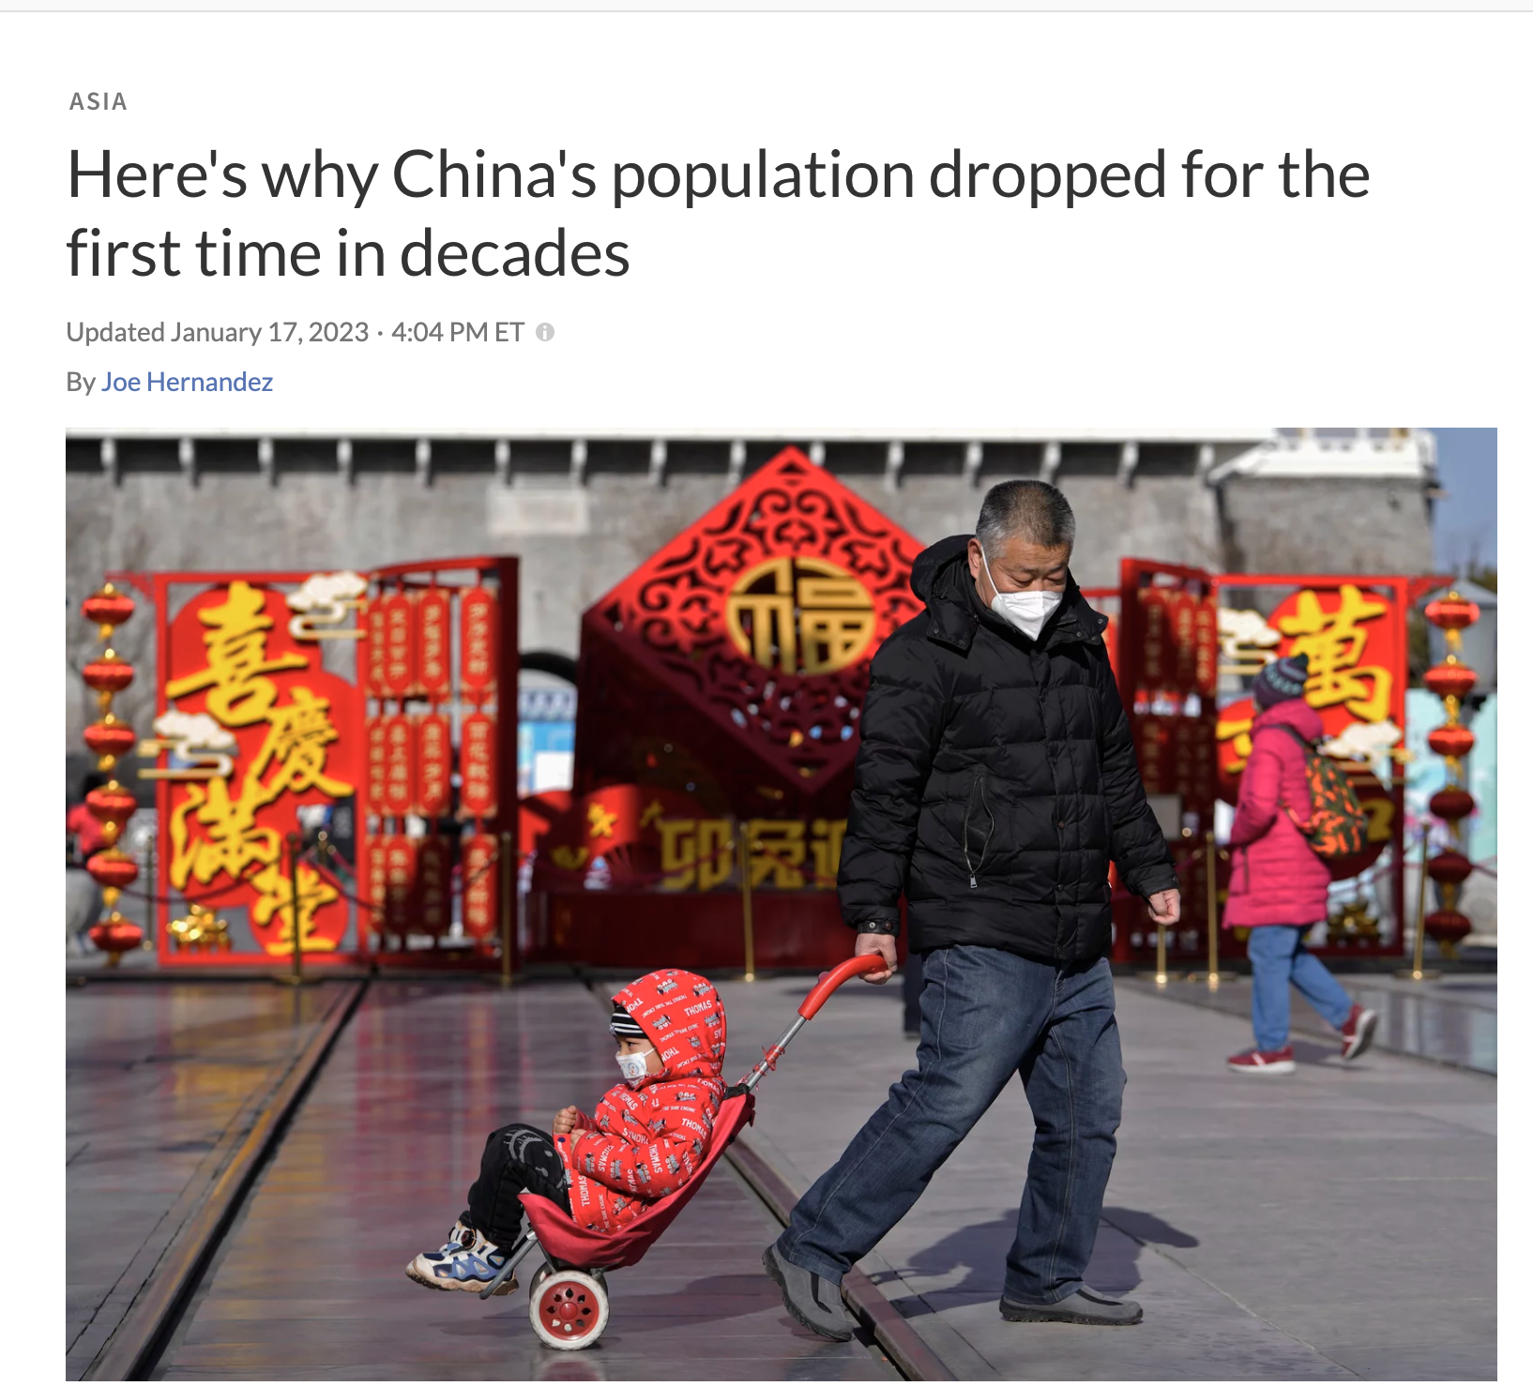
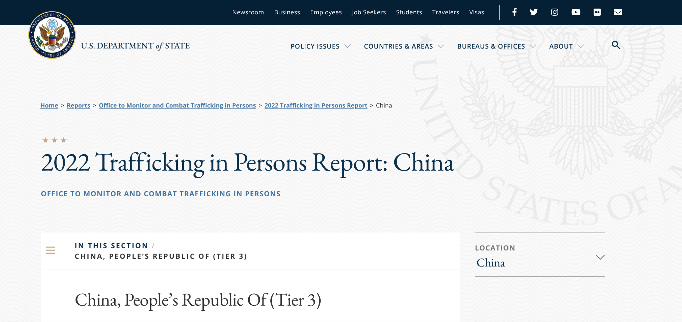
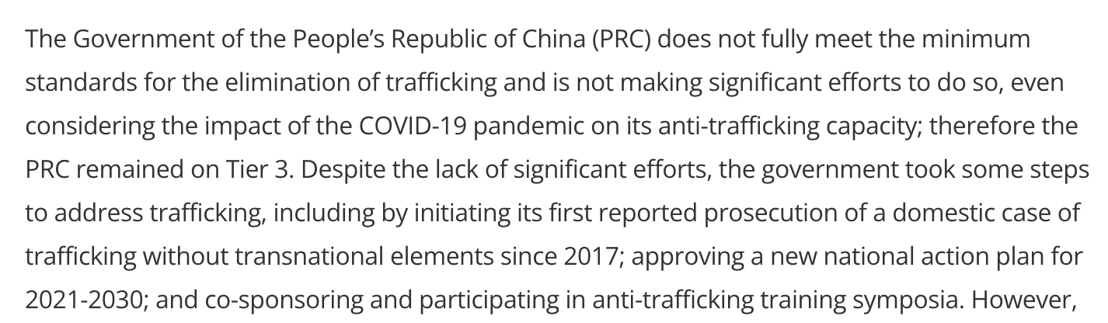
Consequences of “Missing Women Problem”
Sources: https://www.nytimes.com/2023/03/26/world/asia/china-crackdown-bride-prices.html#:~:text=Known%20in%20Mandarin%20as%20caili,paid%20by%20the%20groom's%20parents.
https://indianexpress.com/article/lifestyle/life-style/in-china-a-debate-over-sanitary-pads-on-trains-reflects-long-held-beliefs-about-women-and-menstruation-8230576/
https://www.state.gov/reports/2022-trafficking-in-persons-report/china/

Slide 8
Antagonism between men and women
Case Study 1: Whether the trains should sell female sanitary products
Basic Facts
On Sept 15th 2022 – a female posted her dilemma and suggested a service improvement
On Sept 17th 2022 – This post became viral on various social media platforms and people’s opinions are divided.
60,000 Related News, 9.6 hundred million Reading and 257 thousand Discussion
Conflicts:
Males: dealing with menstruation is a personal business for women and trains has no duty to offer female sanitary products. Women overreacted on this problem.
Women: having a period on train without sanitary pads is a real trouble and sanitary products should be sold normally like any other goods. Men showed no empathy on this problem.
Reasons Behind:
Menstrual Shame & Ignoring Women’s Needs & Women are underrepresented
Sources: https://www.zhihu.com/topic/26257189/hot
https://www.nytimes.com/zh-hans/2022/09/22/world/asia/china-women-period-sanitary-pads.html
Notes:
a female posted her dilemma and suggested a service improvement that the train should sell female sanitary products
This post became viral on various social media and leads to heated discussion
The main conflicts between genders are

Slide 9
Antagonism between men and women
Case Study 2: Skyrocketed bride price
Basic Facts
Usually between 10,000 and 100,000 RMB, especially a tradition in rural areas in China. The uprising pride price leads to lower marriage rate.
Conflicts:
Males: especially low incomes ones, cannot afford such a high bride price and cannot get married.
Female: especially rural ones, justifies bride price because of taking all family chores, giving birth to children and taking care of the whole family after marriage. Don’t want to get married without bride price.
Reasons Behind:
Objectification of women, the Dilemma of Women without Economics Independence & Few laws protecting women’s rights in marriage and family.
Sources: https://cn.nytimes.com/china/20230327/china-crackdown-bride-prices/
https://finance.eastmoney.com/a/202302142635301836.html

Slide 10
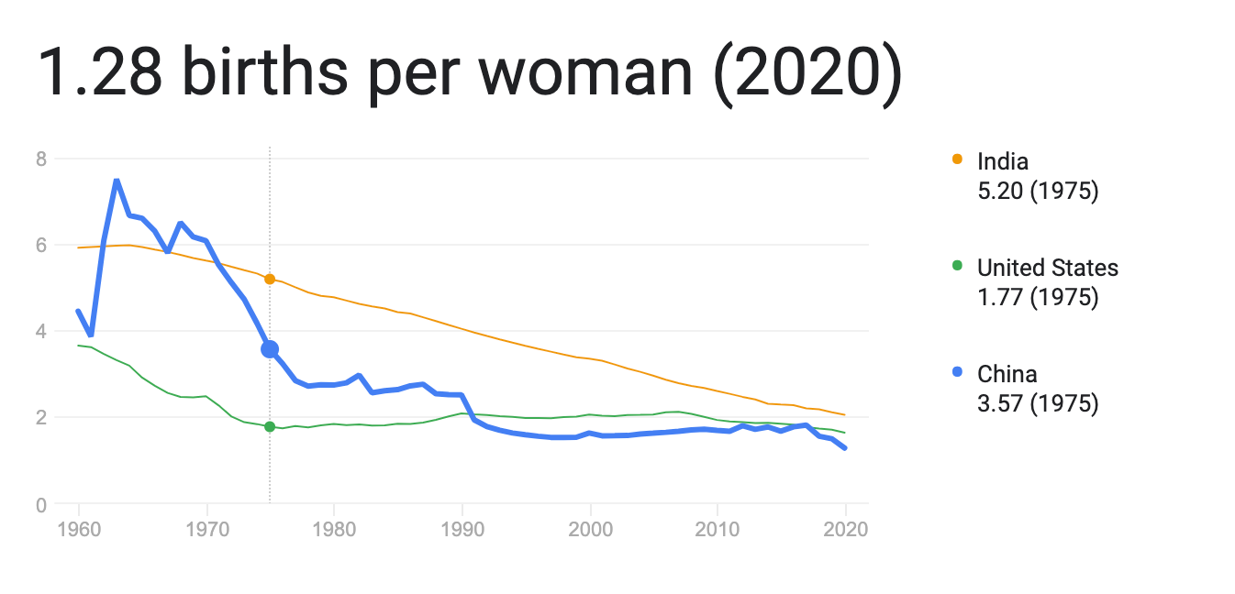
The decline of birth rate of China
Present Situation:
-The birth rate is only 1.3, which decreases 33% since the two baby policy.
-The aging population proportion increase.
Consequence:
-Reduction in productivity due to the disappearance of the demographic dividend period.
-Decreasing in employment rate, wages and consumer spending.
-Aging population issue.
Cause of Decline
-Birth Control Policy.
-High cost of raising a child.
-Rational attitude toward giving birth.
Sources: https://zhuanlan.zhihu.com/p/102560424
http://www.stats.gov.cn/sj/pcsj/

Slide 11
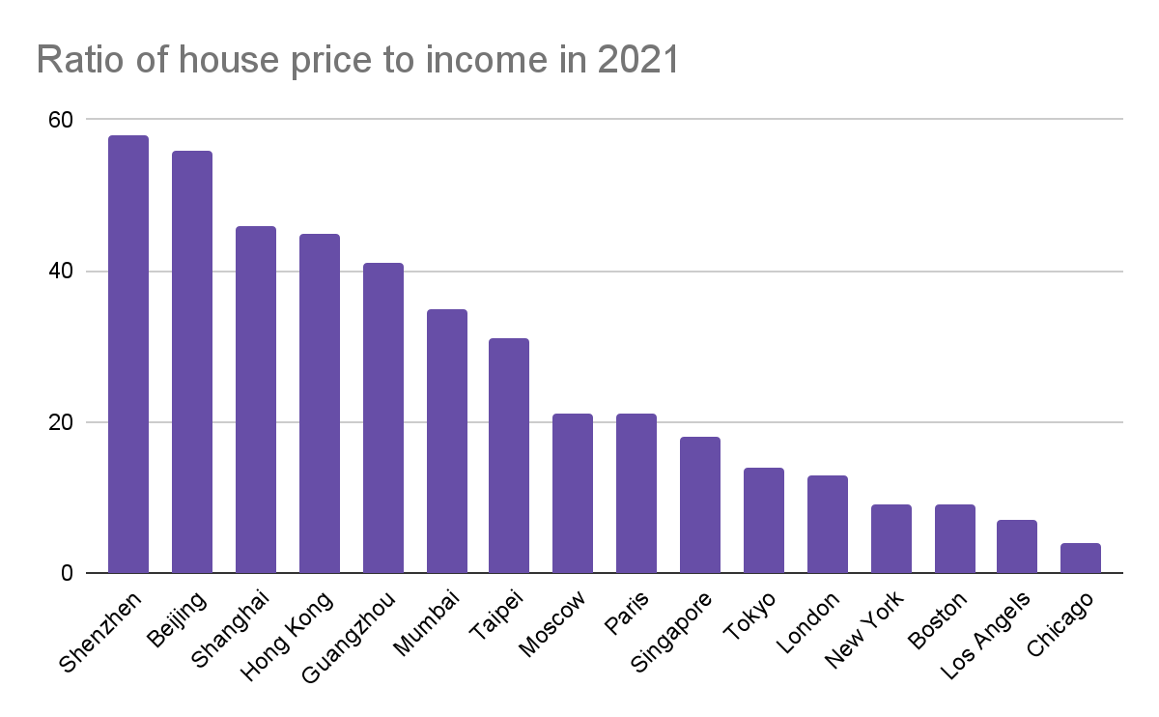
Two-Child/Third-Child Policy
Problem of the Family Planning Policy:
-Ineffectiveness toward the current situation.
-Impairment to women’s right and reproductive autonomy.
-Reinforcement of the traditional gender roles.
http://www.stats.gov.cn/sj/pcsj/

Slide 12
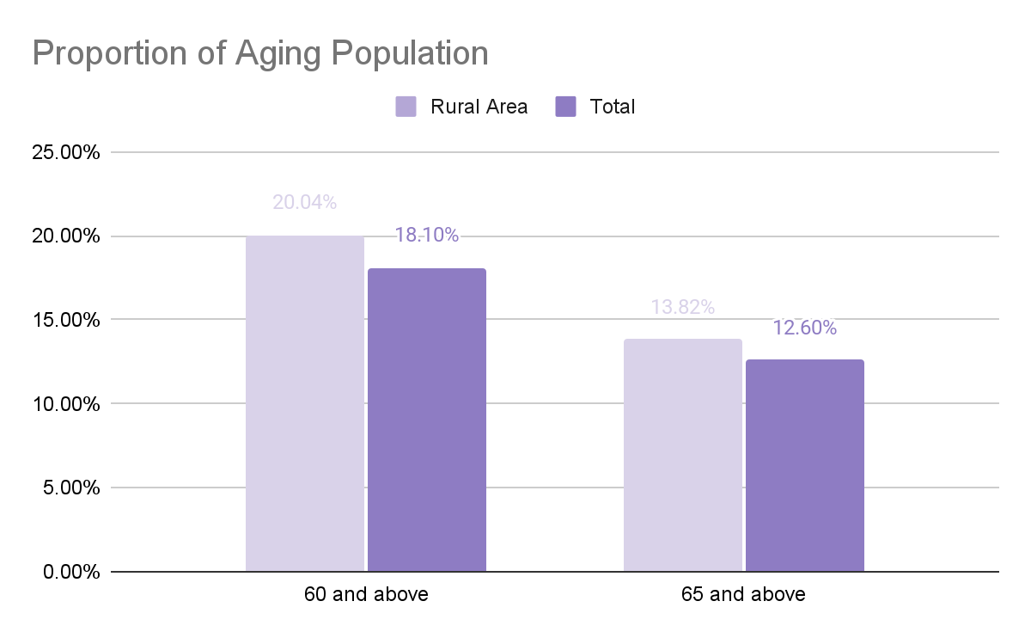
Aging population - Facts
Aging society: 7-14%
Elderly society: 14-20%
Super-aging society: Over 20%
Sources: https://www.chinanews.com.cn/sh/2022/05-06/9747923.shtml
https://www.un.org/en/global-issues/ageing
Notes:
"The Comprehensive Survey and Research Report on China's Rural Revitalization 2021" jointly hosted by the Rural Development Institute of the Chinese Academy of Social Sciences and the Chinese Social Sciences Press.
the proportion of the population aged 60 and above reached 20.04%
the proportion of the population aged 65 and above reached 13.82%
the statistics completely meets the standard of an "aging society" and is very close to the standard of an "elderly society
The social aging rate is calculated based on the proportion of the elderly aged 65 to the population

Slide 13
Aging Population - Reasons
Gender Imbalance
Due to China's one-child policy and traditional cultural values that favor male children, many families in rural areas have a strong preference for male children. As a result, many men in rural areas are unable to find a spouse.
Migration
Many young people in rural areas have migrated to urban areas in search of better job opportunities, leaving behind an aging population. This has also contributed to a decline in the marriage market in rural areas, as there are fewer young people available to get married.
Sources: https://bmcpublichealth.biomedcentral.com/articles/10.1186/s12889-022-13757-x
Notes:
The collapse of the marriage market in rural China may contribute to the aging population in rural areas by reducing the number of births and increasing the number of elderly individuals who are without care or support from children. This is due to the fact that in many traditional Chinese families, adult children are responsible for caring for their elderly parents. When women leave rural areas for urban areas to find work or marriage partners, it reduces the number of potential partners for men, making it harder for them to find a spouse and start a family. This can lead to a decline in birth rates, and in turn, contribute to the aging population in rural areas.

Slide 14
Aging Population - Issues
Labor Shortage
As elderly individuals become less physically capable, they may no longer be able to work, leading to a shortage of labor in rural areas. As a result, they may become more vulnerable to poverty.
Health Care Challenges
Elderly individuals in rural areas often face challenges in accessing health care services due to a lack of medical resources and facilities, as well as a shortage of medical professionals.
Social Isolation
Elderly individuals in rural areas may be more isolated and have limited opportunities for social interaction, which can have negative effects on mental health and well-being.
Sources: https://www.scmp.com/comment/opinion/article/3193390/chinas-rapidly-ageing-society-elderly-rural-residents-must-not-be

Slide 15
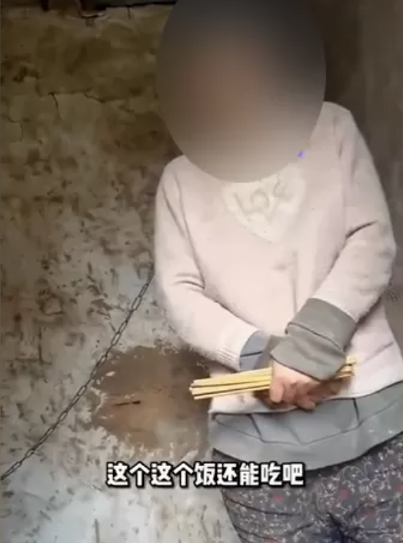
The women’s trafficking
On the evening of January 27, 2022, mainland Chinese blogger "Xuzhou Yixiu Brother" released a video of his residence of Dong Zhimin on the audio and video platform. It can be seen in the film that Dong Zhimin dresses and eats the child in the room, and his wife is tied to her neck by the iron chain and locked in a broken house next to the big house. The local temperature is close to 0 degrees. After the image was exposed, many well-known Internet celebrities and netizens paid attention and forwarded. Many people left messages to worry that the iron chain woman was trafficked and domestic violence, and called for the police.
After the "eight -child girl" was confirmed, the police touched the vine and found the Sang girl who brought him out of Yunnan. In December 2000, Sang Niu and his husband were sentenced to five and seven years in prison for other trafficking women and children's crimes. According to the police, Sang Niu took Xiaohua Mei to Jiangsu and sold to Xu Moudong in Donghai County. Xiao Hua Mei did not know where to live in Xu Moudong's family for a while.
“Xuzhou Mother: Video of Chained Woman in Hut Outrages China Internet.” BBC News, BBC, 31 Jan. 2022, https://www.bbc.com/news/uk-60194080.

Slide 16
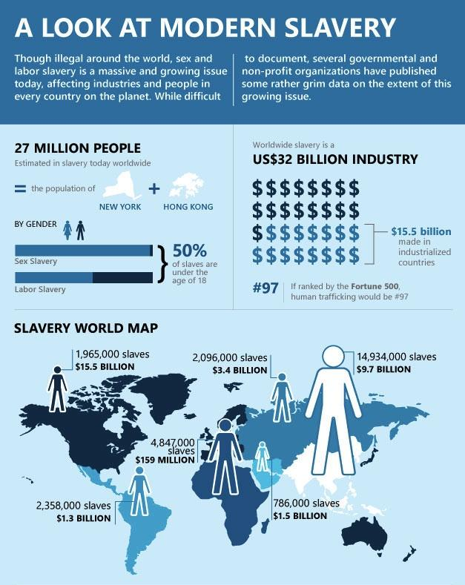
Transnational Population Trading
According to data from the United Nations Refugee Agency, among the world's population trafficking, men, adult women, and children are the most proportion of adult women.
Among them, adult women account for 51%, adult men are 21%, female children are 20%, and male children are 8%. Women account for 70% of the sale of population.
(Human trafficking and international law, Elizabeth Willmott-Harrop, 30 October 2013)

Slide 17

Organ Sales
More and more research reports and press articles started to inform about conducts amounting to trafficking in persons for the purpose of organ removal, and the harmful physical, psychological and emotional effects on ‘donors’, who sell their organs on the black market to alleviate their poverty.
The further law should be set to prohibit the illegal organ sales as well as to release the pressure for organ recipients.
China’s law stipulates that non -voluntary donations of organs for transplantation are illegal, but how to protect their personal safety from the legal level for women and children who have been trafficked, and conviction of possible organs will be part of future legal construction.
Trafficking in Persons for the Purpose of Organ Removal - United Nations. 11/2021

Slide 18


Thank You for Listening
Q&A

